Slide 1
SOLEIL status update
Dan Costin & Martin Savko
{costin, savko}@synchrotron-soleil.fr
MXCuBE/ISPyB meeting at Elettra November 22 2024

Slide 2
Synchrotron SOLEIL
energy: 2.75 GeV
current: 500 mA
electron beam lifetime: ~11 hours
circumference: 354 m
emittance (horizontal, vertical): 3.7x10⁻⁹, 11x10⁻¹² m.rad
brilliance: 10²⁰ ph.s⁻¹.mrad⁻¹.mm⁻² @ 0.1% bandwidth
founded in 2001, in operation since 2006
funded jointly by CNRS (72%) and CEA (28%)
350 employees

Slide 3
Proxima 1
Proxima 2A
Source: U20 in vacuum undulator
Focussing: KB, CRL, 20x40 μm, project for new KB mirrors
Tunable: Si 111 CCM, 5.5 - 15.5 keV
Flux: 2.0e12 ph/s @ 500mA @ 12.65keV
Area Detector: Eiger X 16M
XRF Detector: Ketek AXAS-M2 H150 (XIA)
OAV Camera: Prosilica GC 1350 (4.65um, 1360x1024)
Goniometer: SmarGon
Sample Changer: CATS (48 cryo, 16 ambient) Looking into getting a bigger dewar !
MXCuBE: Qt4 v 2.3 (CentOS 7), HardwareRepository, Python 2.7
Source: U24 in vacuum undulator
Focussing: KB, horizontal PFM, 5x10 μm
Tunable: Si 111 CCM, 5.5 - 18.5 keV
Flux: 1.6e12 ph/s @ 500mA @ 12.65keV
Area Detector: Eiger X 9M
XRF Detector: Ketek AXAS-M2 H80 (XIA, Xpress3)
OAV Camera: MAKO G-192C (4.50um, 1600x1200)
Goniometer: MD2 with minikappa (MK3), Plate Screener, HC/REX installed, MD3 coming next December !
Sample Changer: CATS (144 cryo, 48 ambient)
MXCuBE: Qt5 (Ubuntu 20.04), mxcubecore, Python 3.8

Slide 4
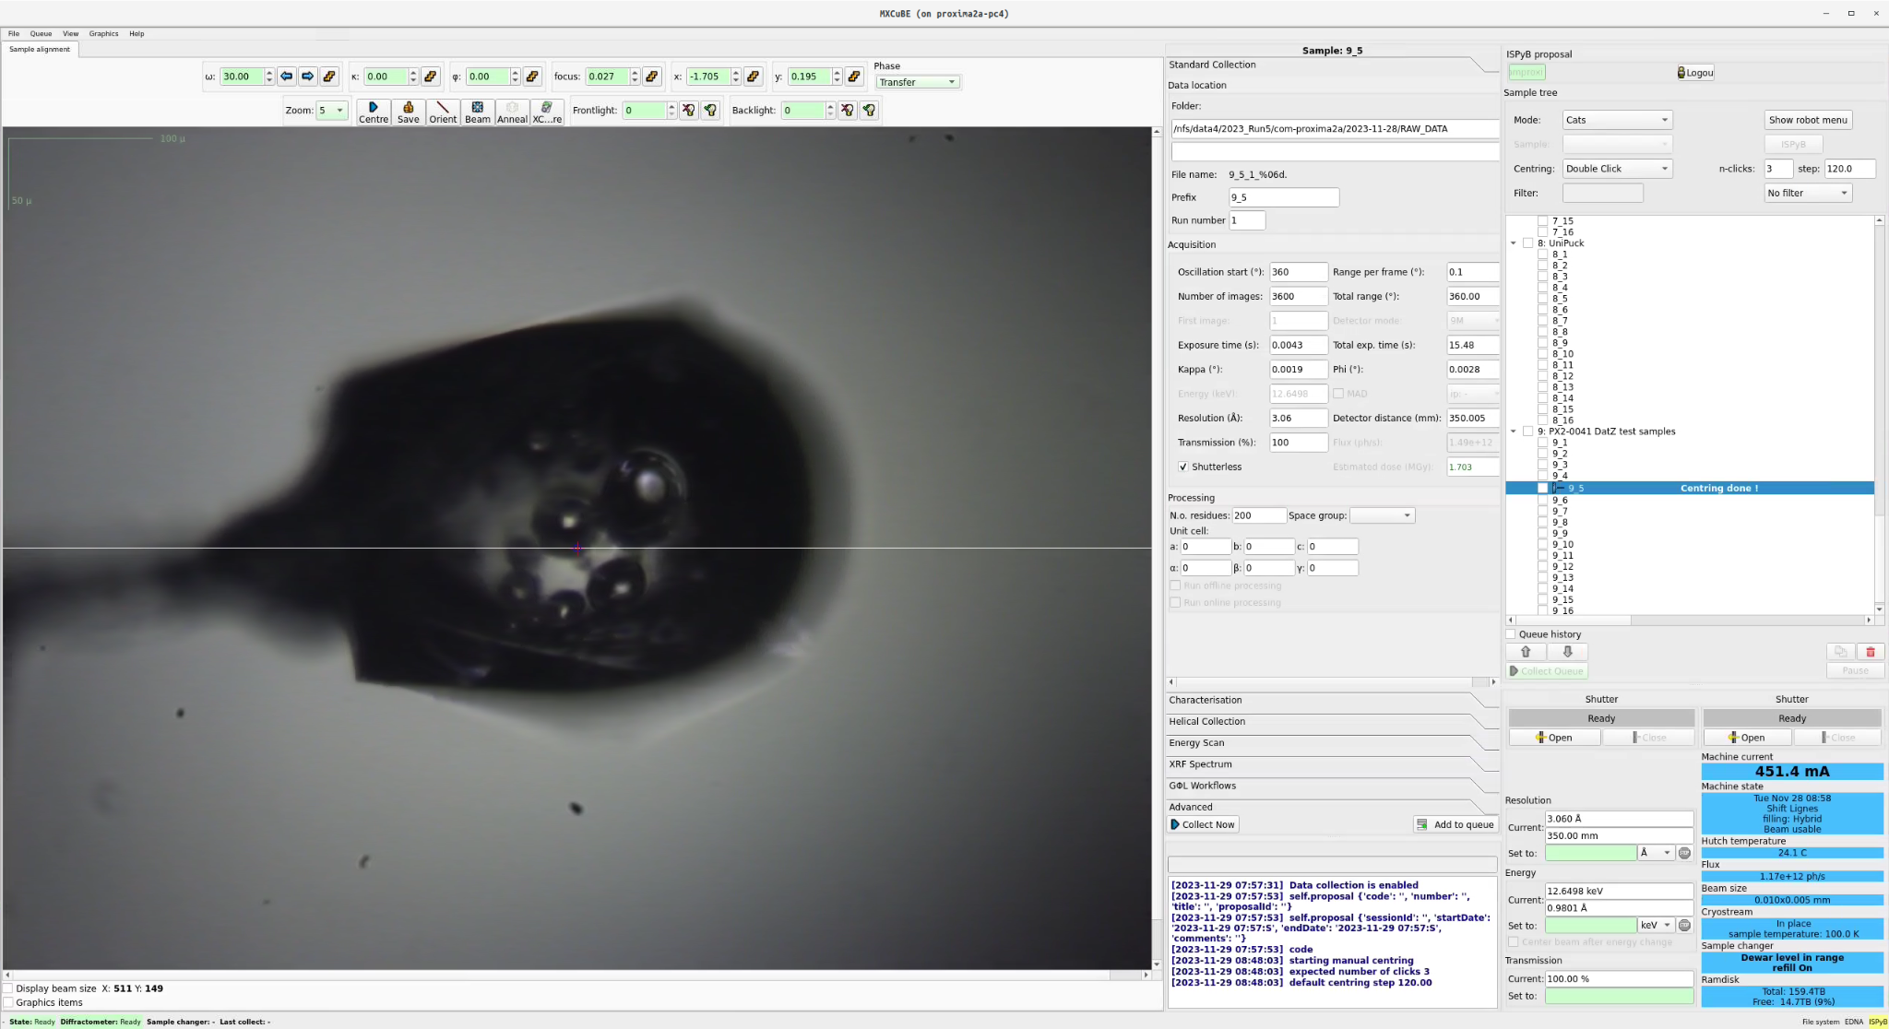

Slide 5
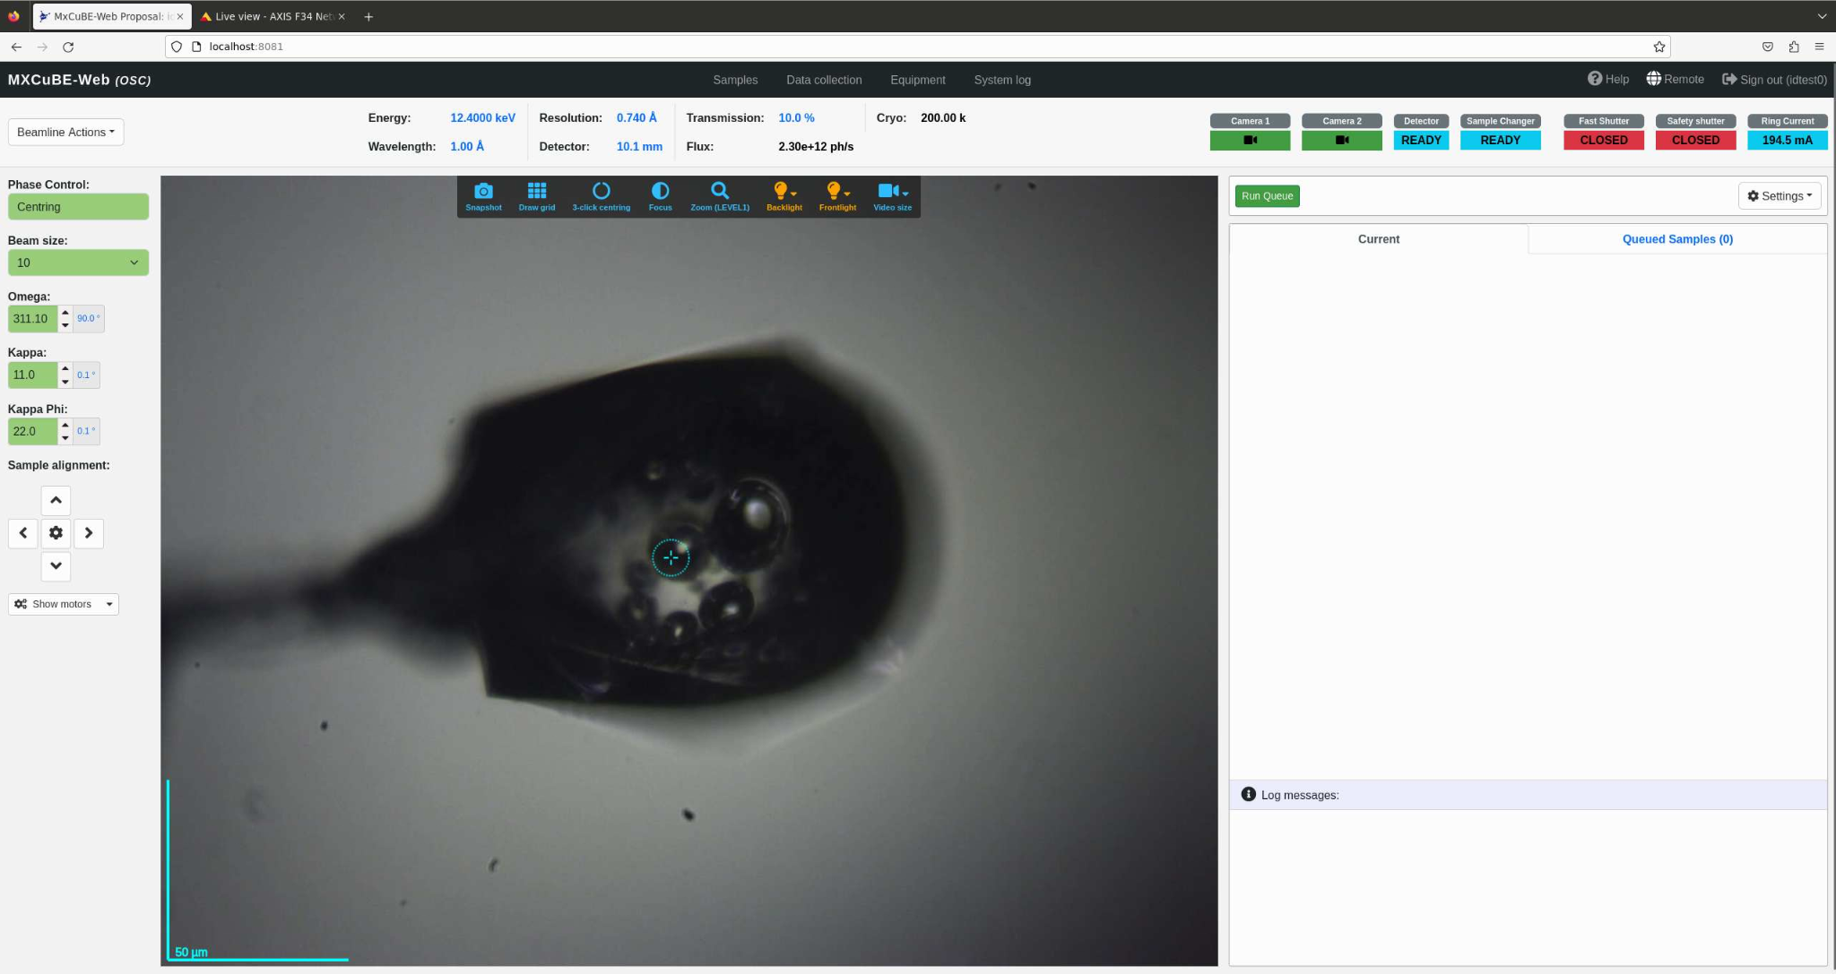

Slide 6
Plans for the past 6 months
Finalizing mxcubeweb adaptation
Murko
diffraction raster scans prediction head: learn crystals and ice!
bounding box and key points in-network inference
Volume aware experiments
sample shape reconstruction + 3d sample shape registration
expressing points, lines, planes and volumes in intrinsic coordinate system
fully automated sample realignment
Concerted push for unattended data collection capability
first simple experimental protocol gradually employing more thorough e.g. using GPhL workflows

Slide 7
Plans for the next 6 months
Finalizing mxcubeweb adaptation
Murko
diffraction raster scans prediction head: learn crystals and ice!
bounding box and key points in-network inference
Volume aware experiments
sample shape reconstruction + 3d sample shape registration
expressing points, lines, planes and volumes in intrinsic coordinate system
fully automated sample realignment
Concerted push for unattended data collection capability
first simple experimental protocol gradually employing more thorough e.g. using GPhL workflows

Slide 8
GPhL Workflows integration status
The workflows available in production since the first run of 2023
Development sessions June 2021, December 2021, February 2022, June 2022
in-house project (9 shifts, validated by research director), extended for 2023 (6 shifts)
The newest version of the workflows available to our users.
MXCuBE at the most recent version.
We will soon boost our processing capacity -- adding 1024 CPU threads and additional GPU cards.

Slide 9
Issues
Minikappa damaged September 2024
fixed in October
still some issues with false collision detection
Monochromator controller failure November 2024
operating at fixed energy

Slide 10
Automation?
Is there a value in automation?
consistent and careful evaluation of sample properties
encoding best practices
consistent and careful evaluation of the instrument performance
Is there a danger in automation?
optimizing for wrong metrics (speed vs. quality)
loss of expertise
mindless experiments
stifling of innovation (difficult to increase capacity of a mind that thinks it is already full of knowledge)

Slide 11
Automation?
… once we have seen how to mechanize some part of our understanding, then we can also see how transcend this mechanization. [Gödel 1931, Penrose 1989]
What distinguishes reality is our inability to describe it to exhaustion [Lanier 2017]

Slide 12
What do we do?
Sample optical evaluation
alignment and centring
shape determination
Diffraction evaluation from stills
diffraction tomography
diffraction quality mapping
Diffraction evaluation from oscillation
few wedges around 360 degrees of rotation
resolution limit
strategy determination
Full reciprocal space mapping
single or more sweeps of diffraction at one or more goniometer settings

Slide 13
Sample optical evaluation

Slide 14
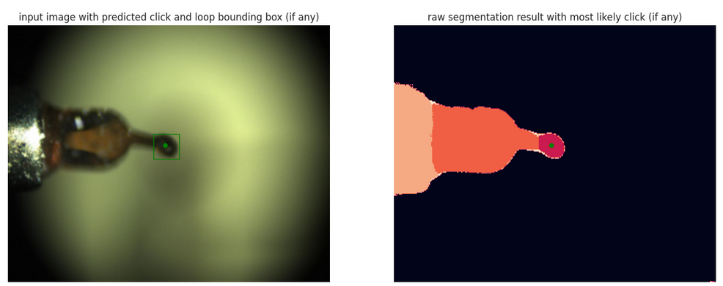
Murko - making sense of sample image

Slide 15
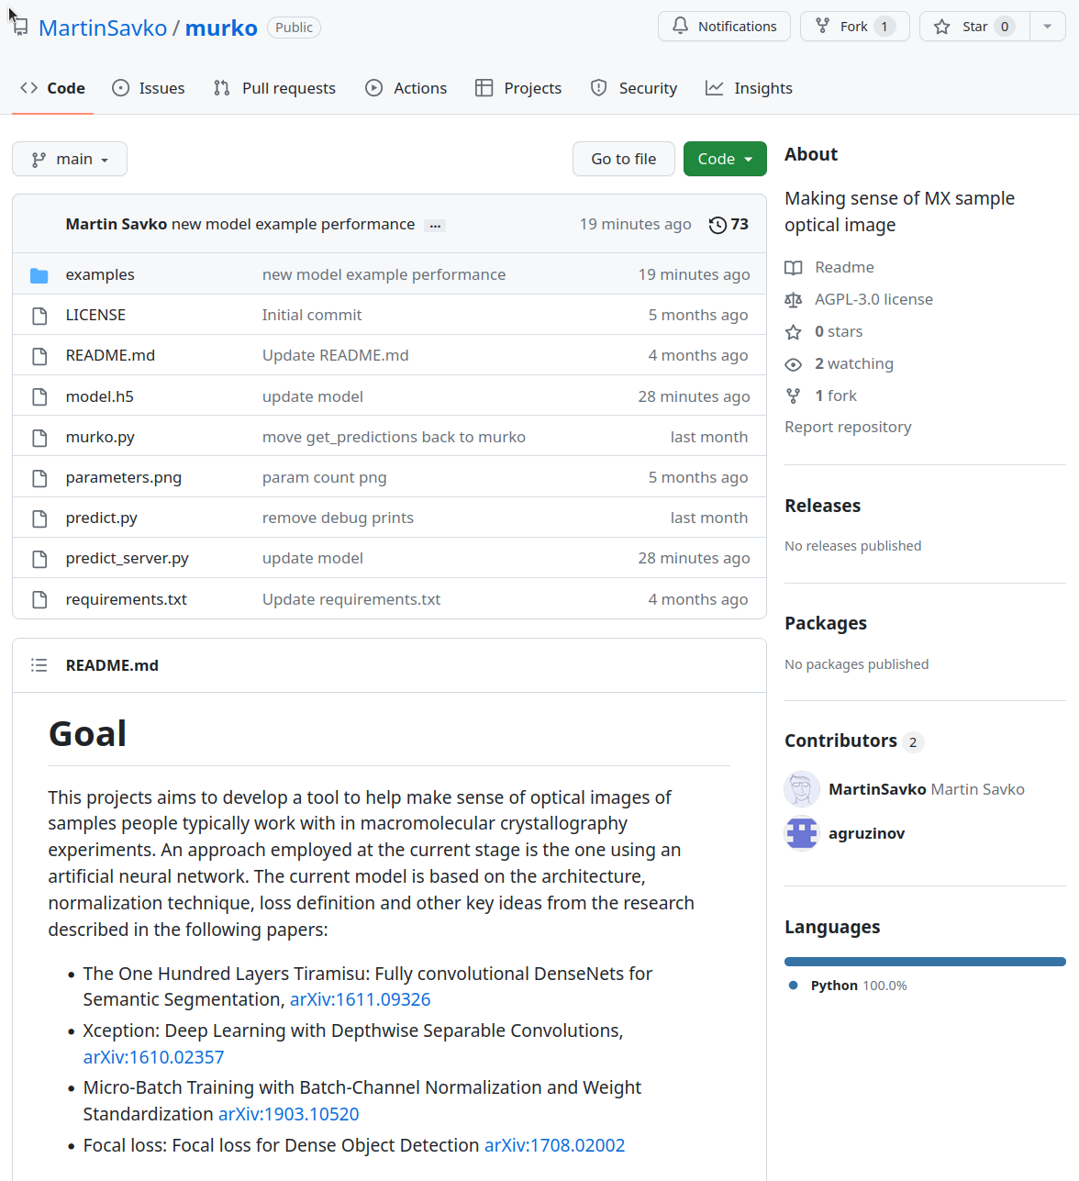
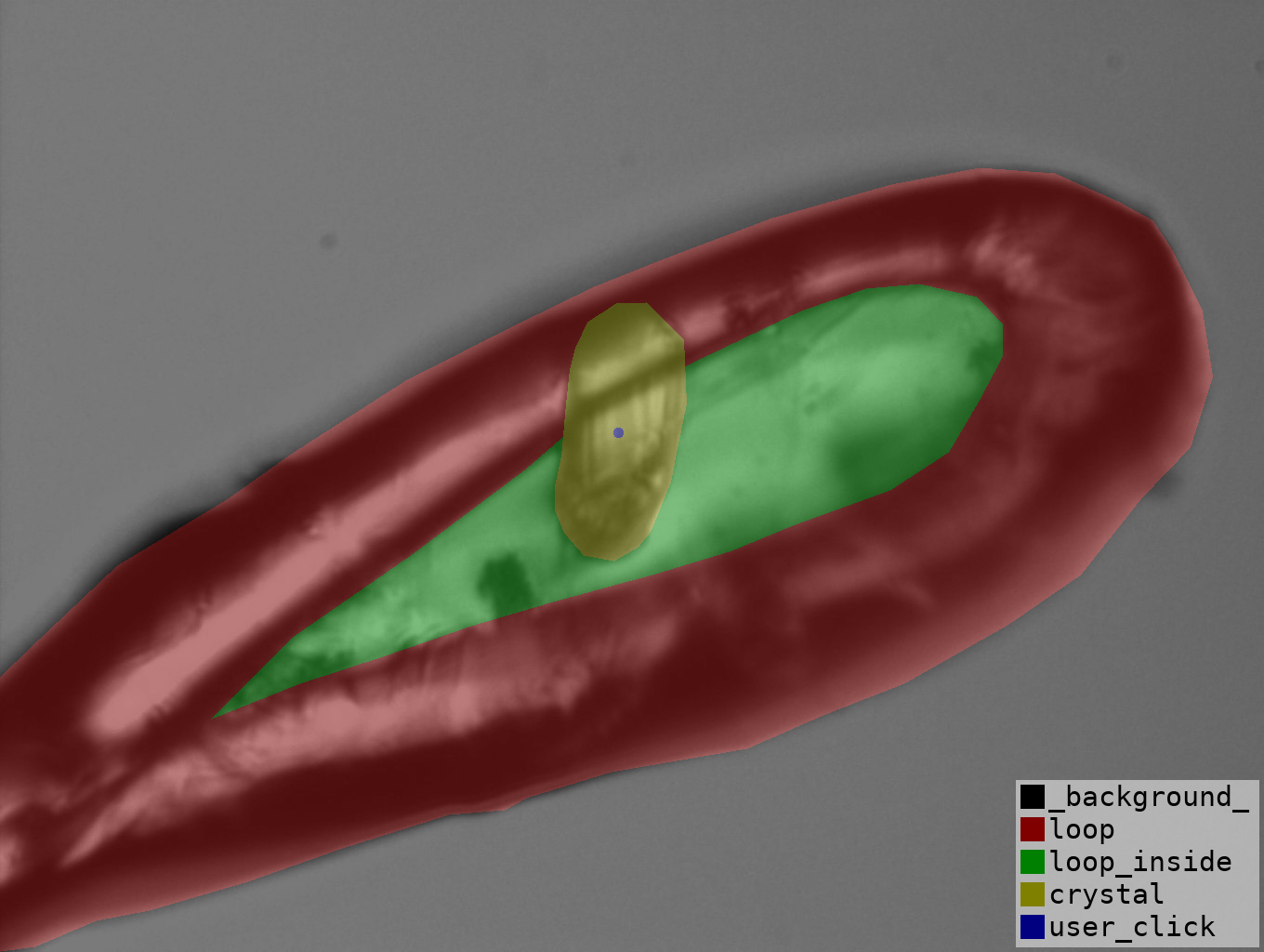
Murko updates
Artificial neural network based model
https://github.com/MartinSavko/murko
103 convolutional layers, 3M parameters
inference time
~65 ms per single image
~15 ms in batch mode
Deployment
0MQ server receives images
returns segmentation maps
New branches
develop, develop_keras_v3, gpu_docker
Collaborations
DESY, SLS, DLS, EMBL, MAX IV, BESSY

Slide 16
Pixelwise annotated images…

Slide 17
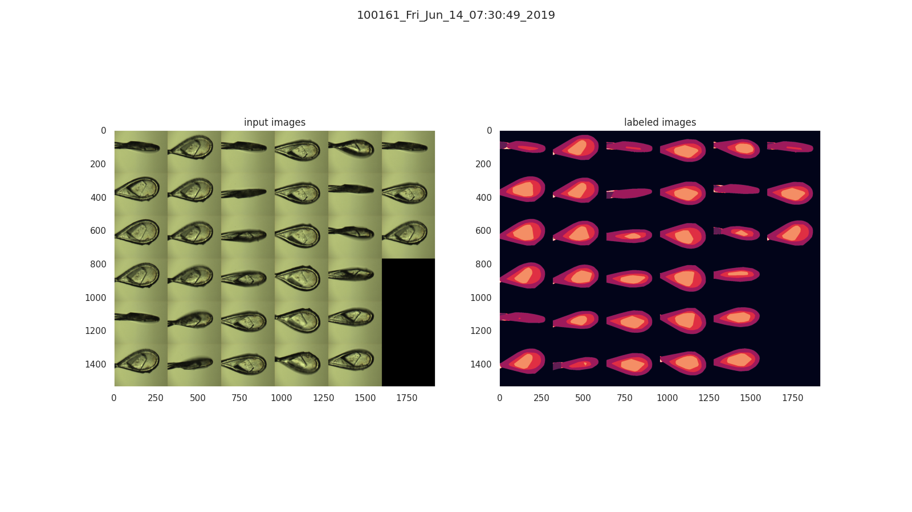
Performance

Slide 18
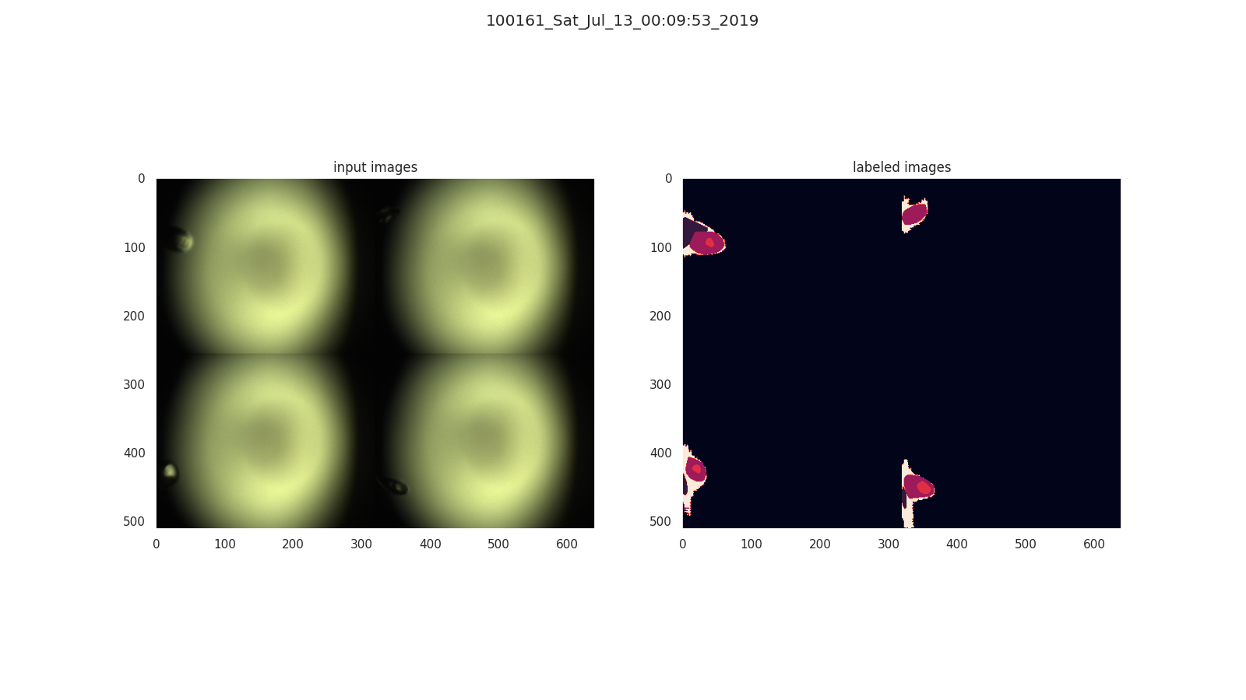
Performance

Slide 19
We sometimes need more accurate models of sample image movement …
although sample moves on a circle as omega axis changes, its image almost never does (only if there is just material of refractive index of 1 around it). It follows much stranger law. Law nonetheless -- one just needs more parameters to model it …

Slide 20
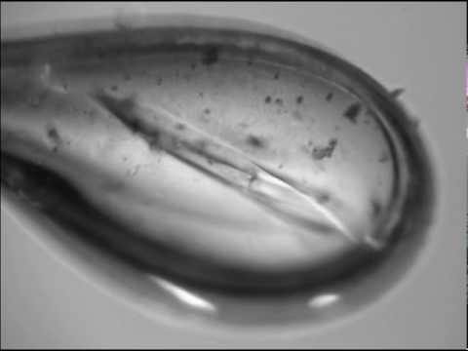

Slide 21
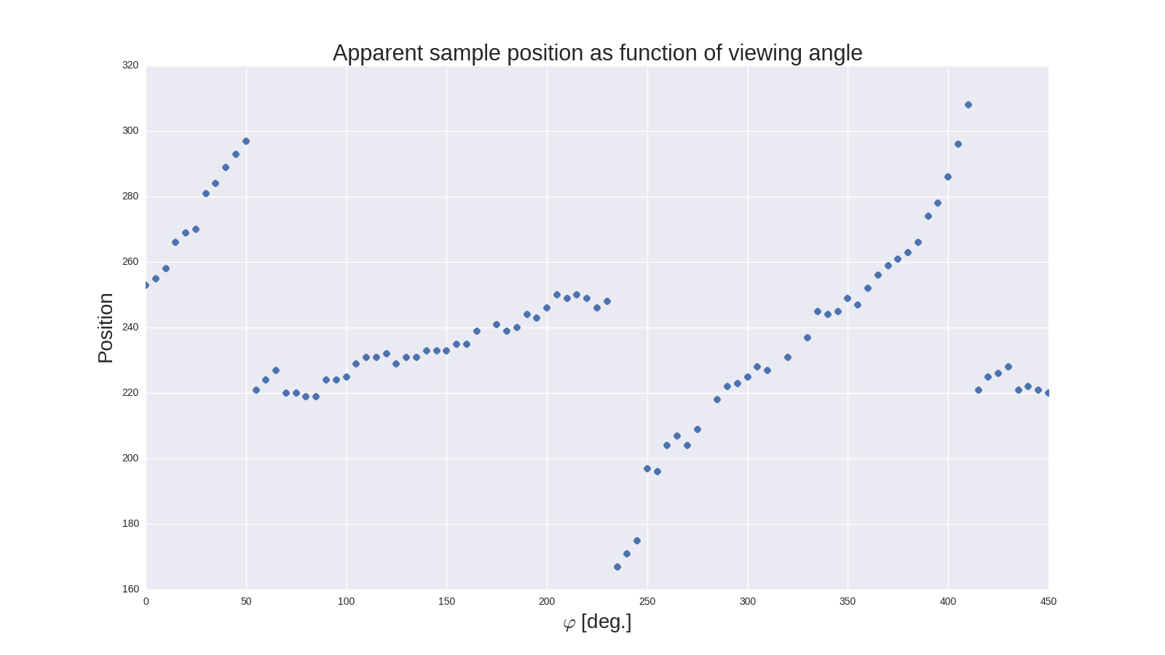
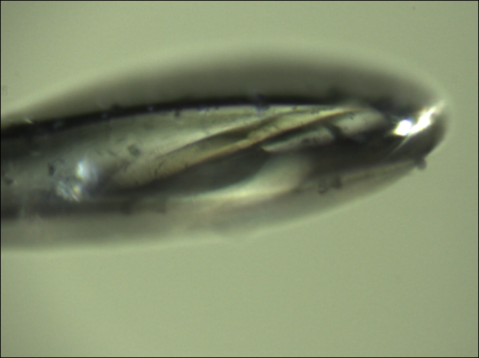
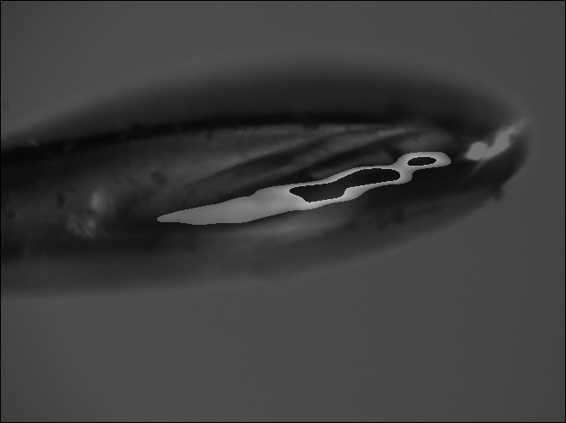

Slide 22
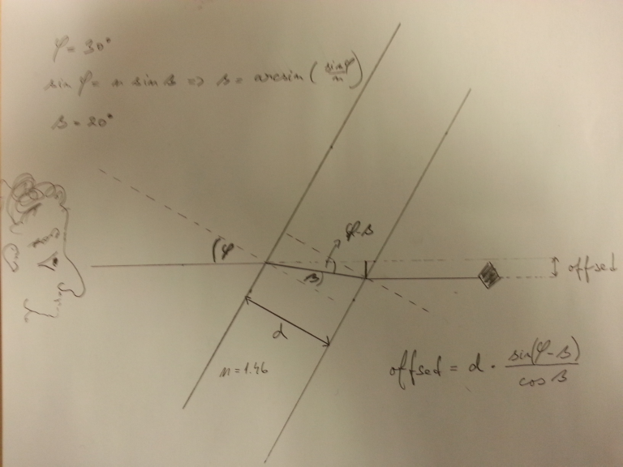

Slide 23
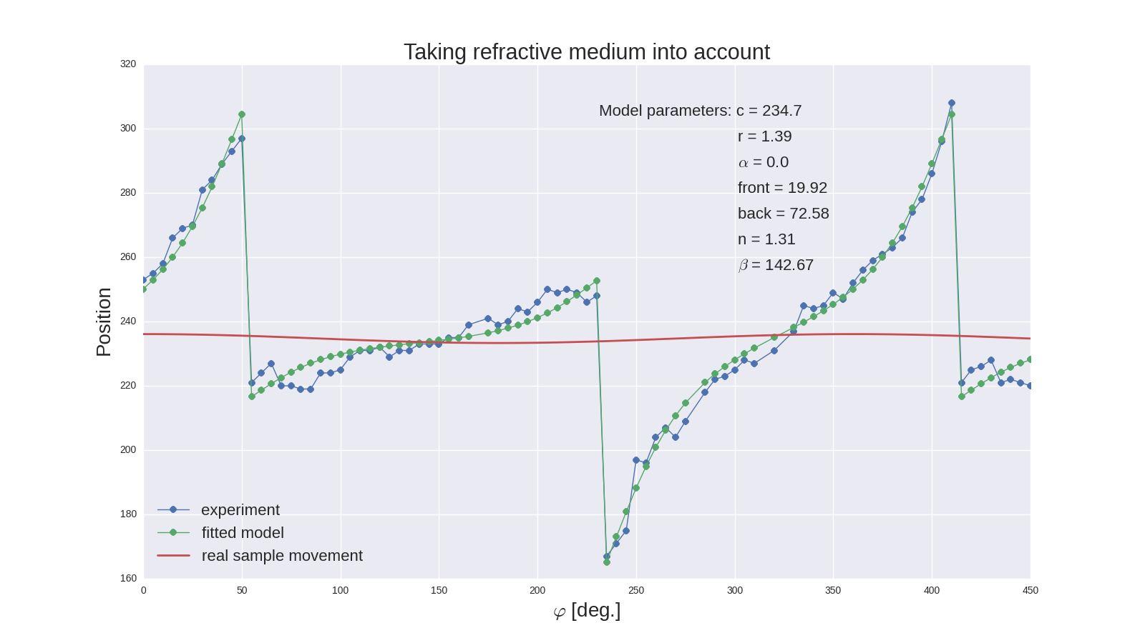
This is example of a sample aligned almost perfectly. It’s image is moving across many microns … it is important to model it well ...

Slide 24
The Slab Model

Slide 25
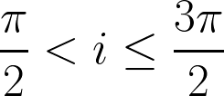
The Slab Model -- two faces/two thicknesses

Slide 26
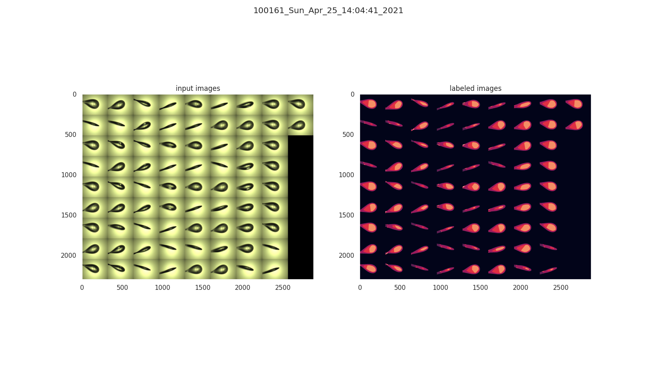
Performance

Slide 27
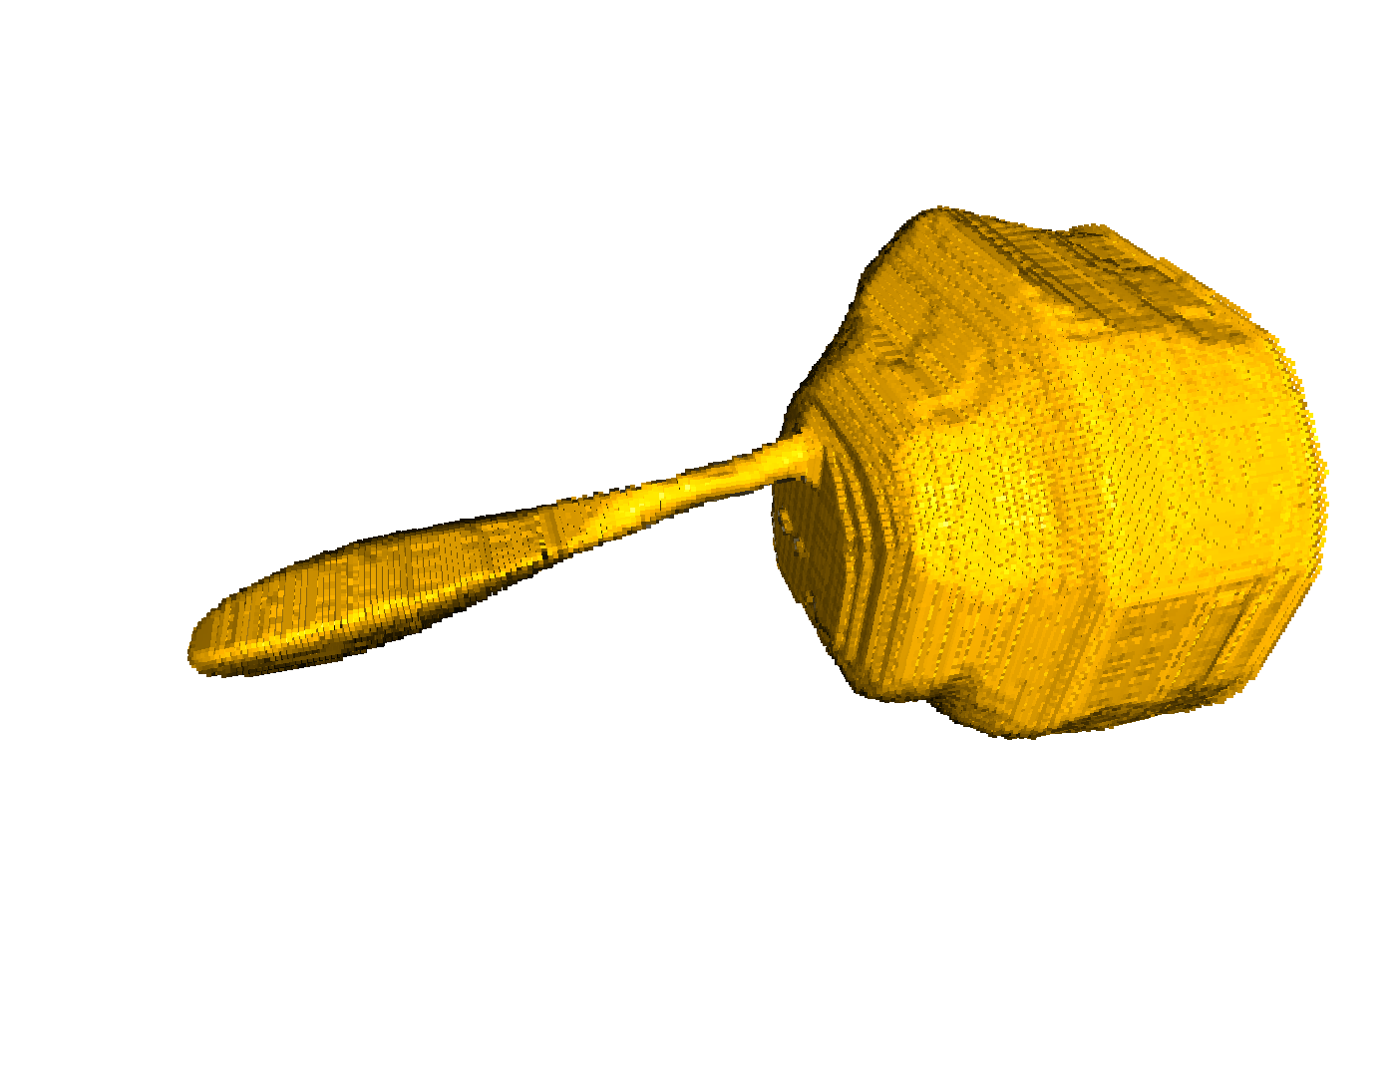
Reconstructed sample shape

Slide 28
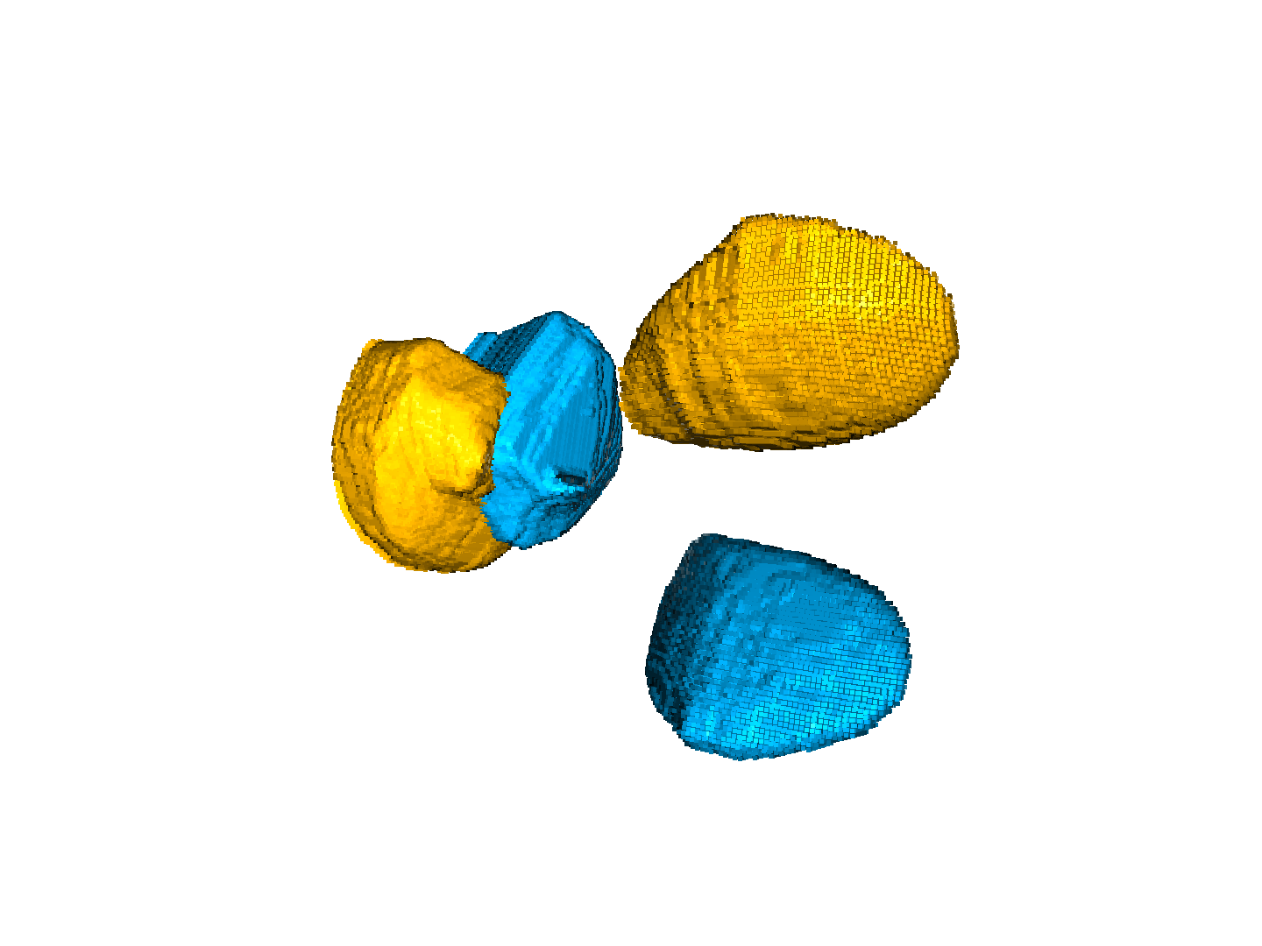
Perfect realignment: input volumes

Slide 29
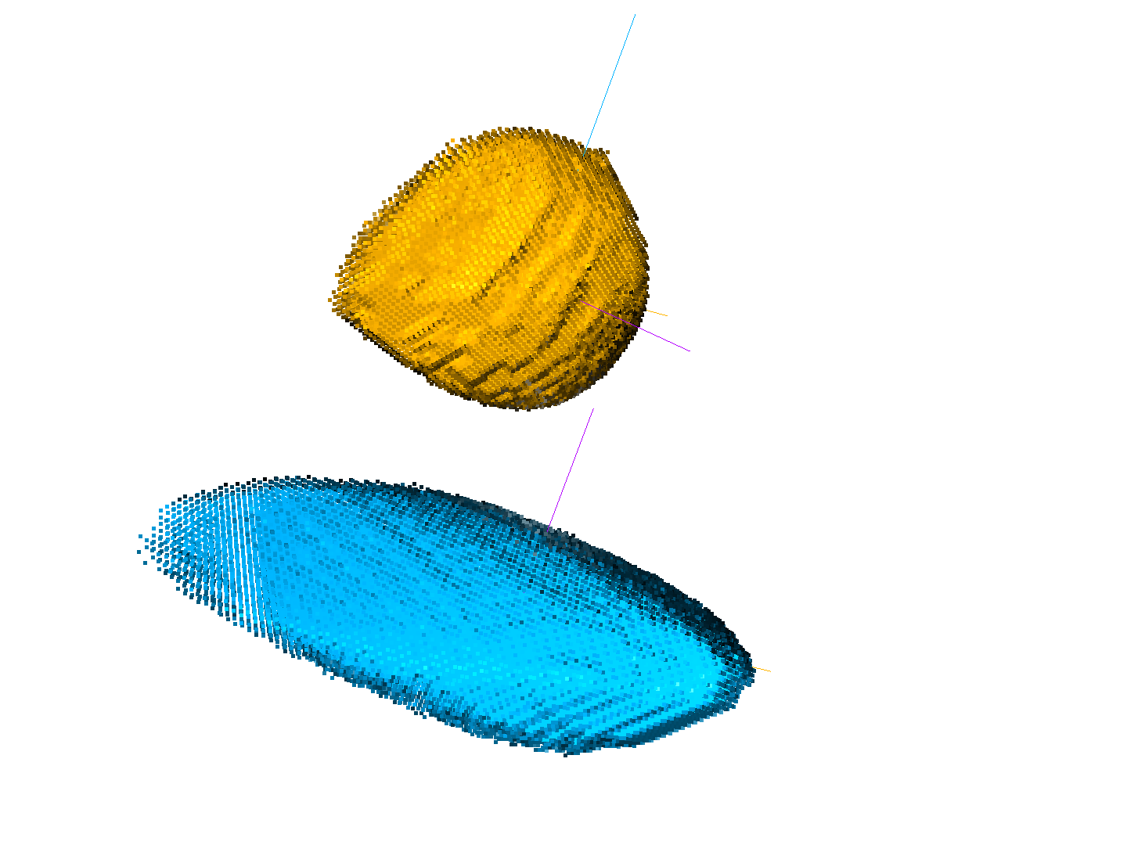
Perfect realignment: parts in focus

Slide 30
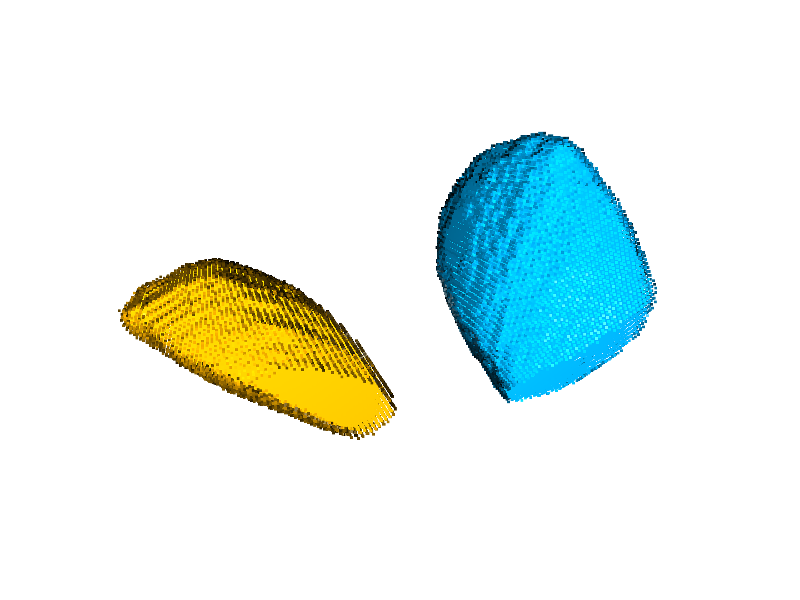
Perfect realignment: in focus, equal volumes

Slide 31
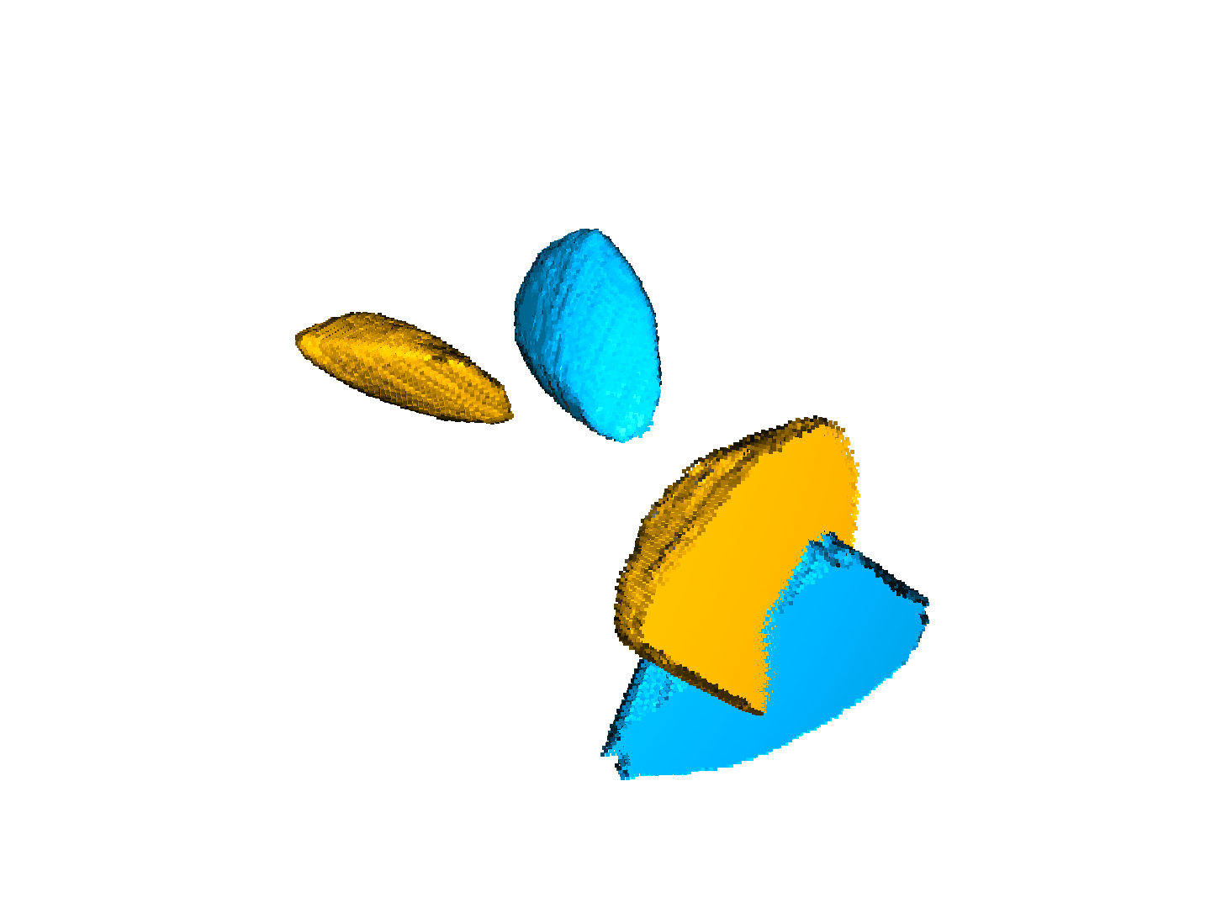
Perfect realignment: parts in both, for validation

Slide 32
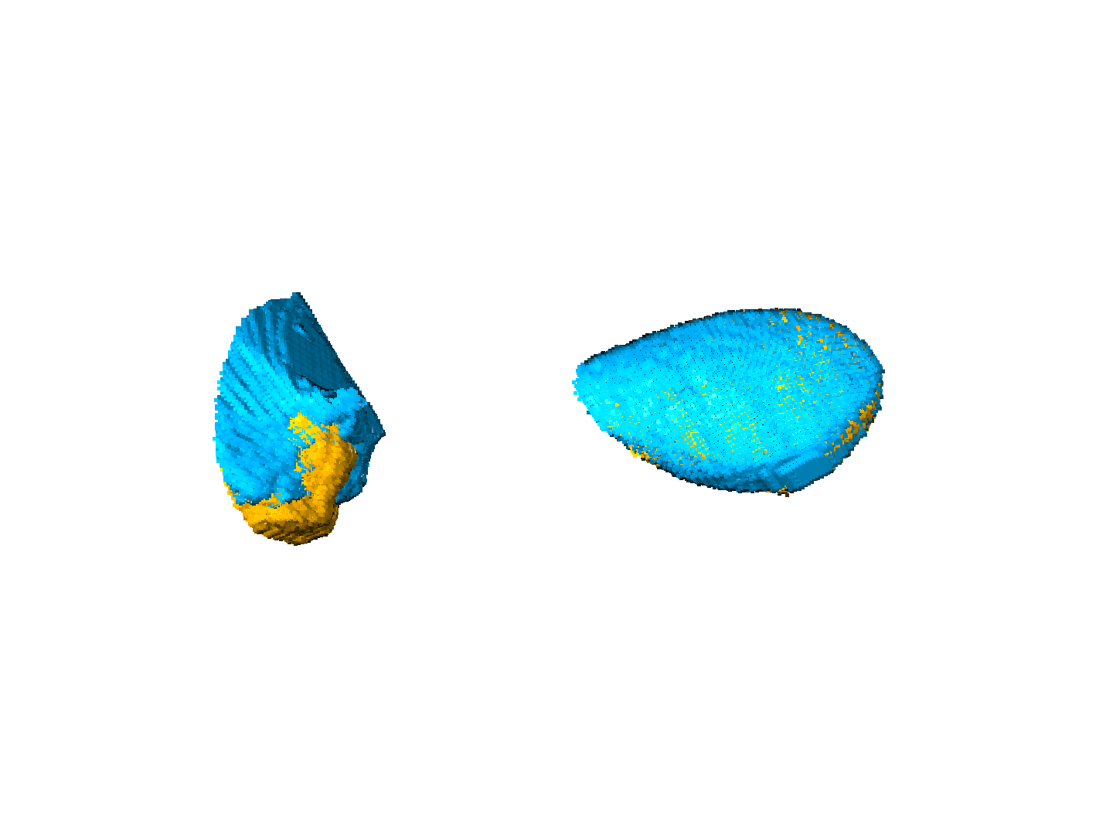
Perfect realignment: coherent axis direction
rmsd: 0.0093

Slide 33
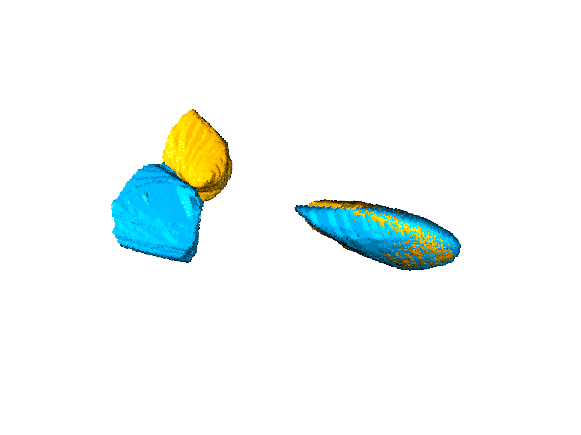
Perfect realignment: coherent axis direction
rmsd: 0.0787

Slide 34
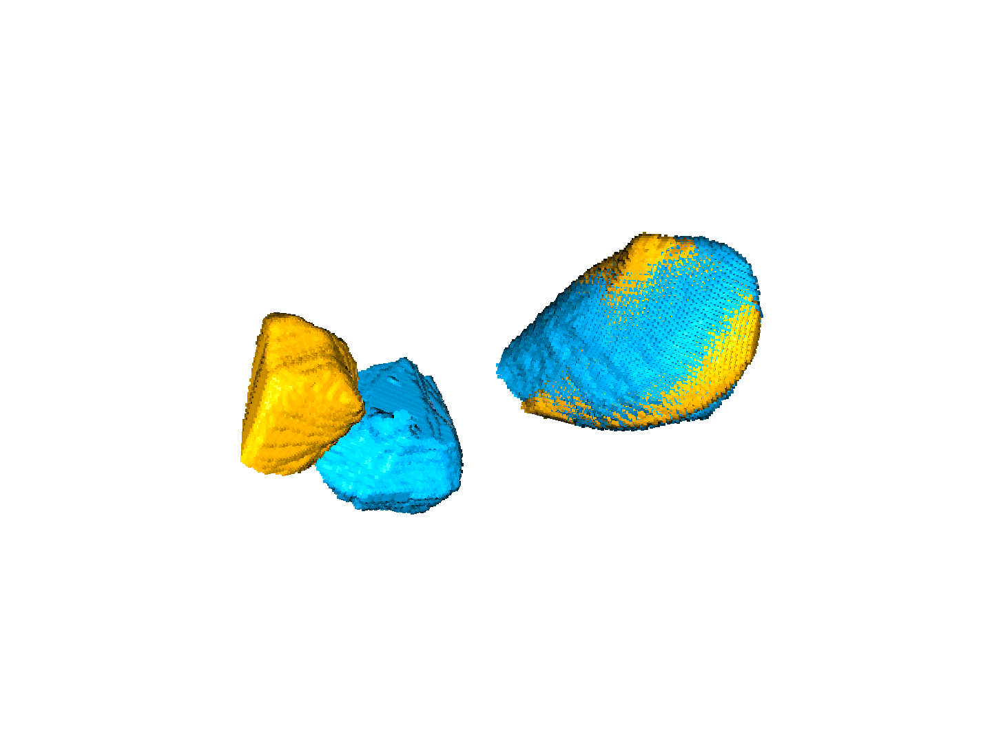
Perfect realignment: coherent axis direction
rmsd: 0.0888

Slide 35
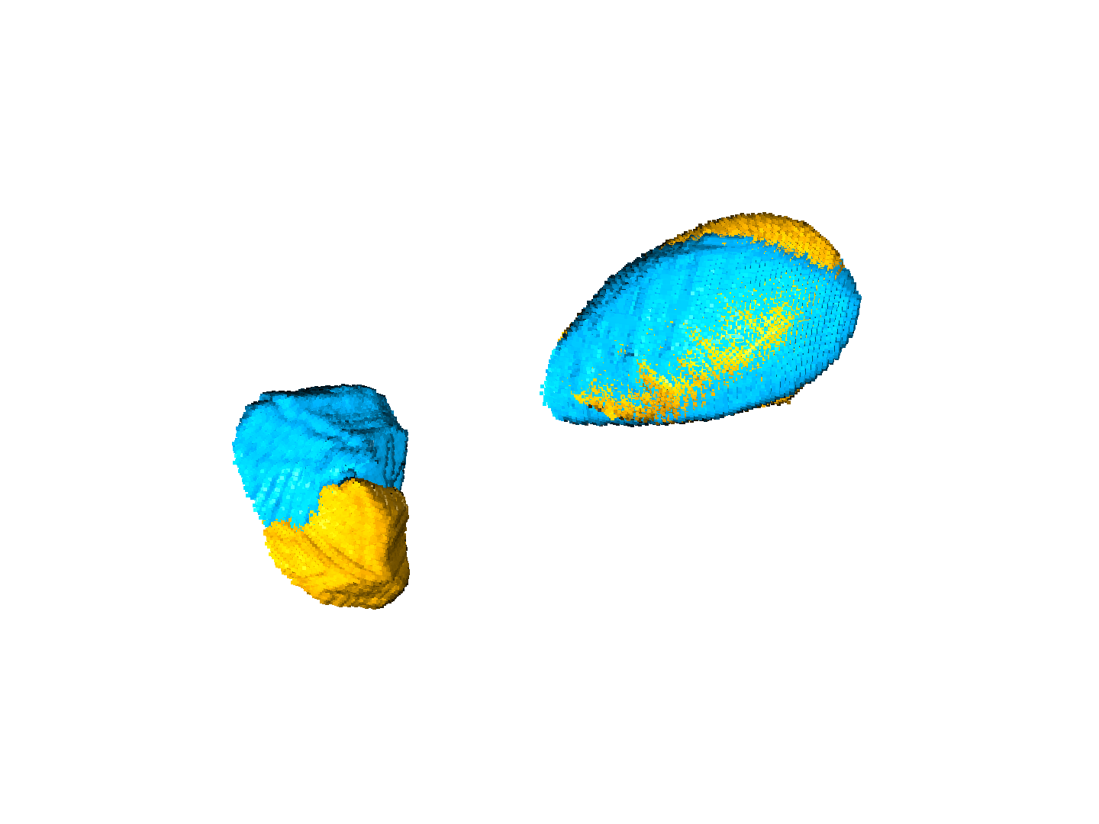
Perfect realignment: coherent axis direction
rmsd: 0.0229

Slide 36
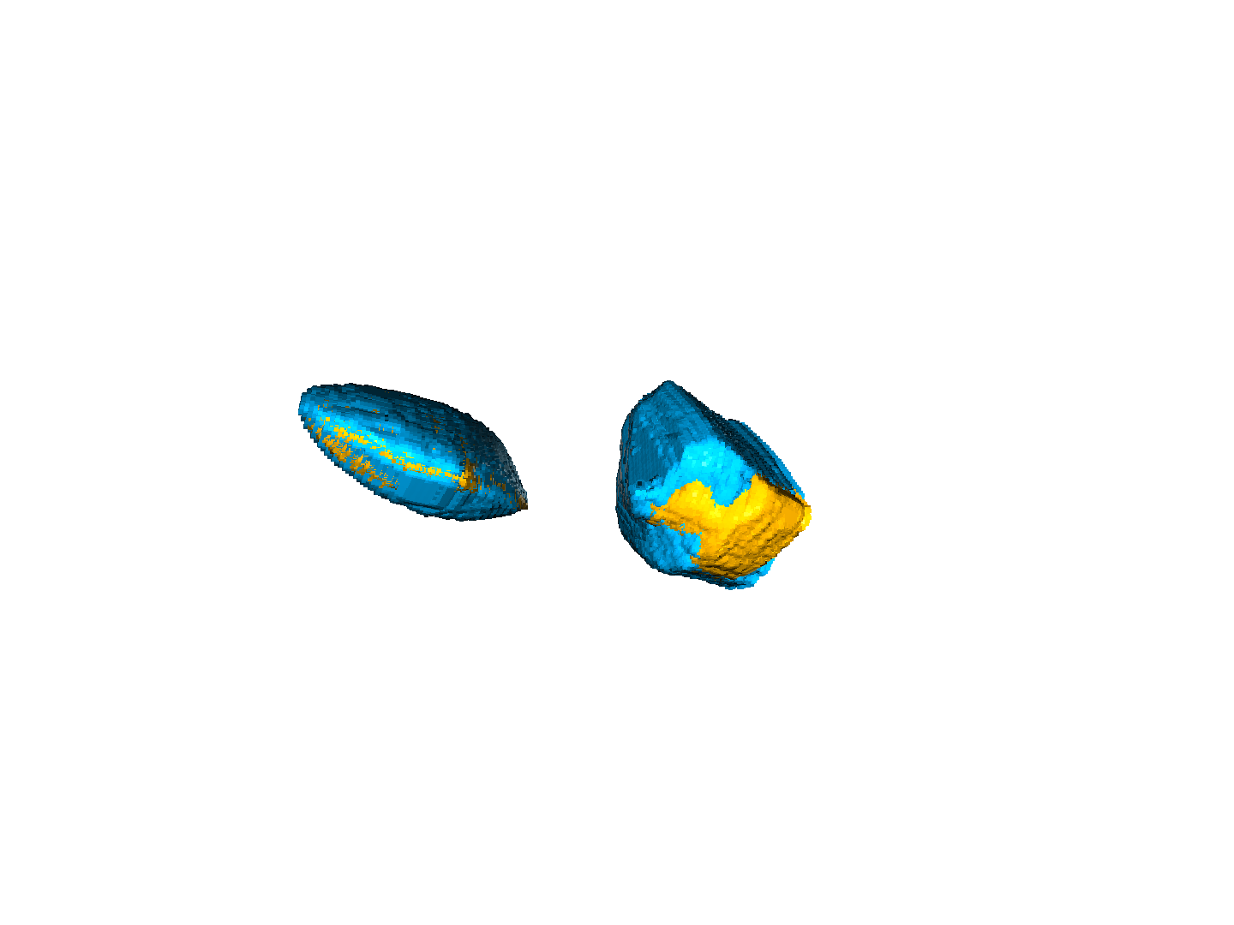
Perfect realignment: coherent directions found!
rmsd: 0.0093

Slide 37
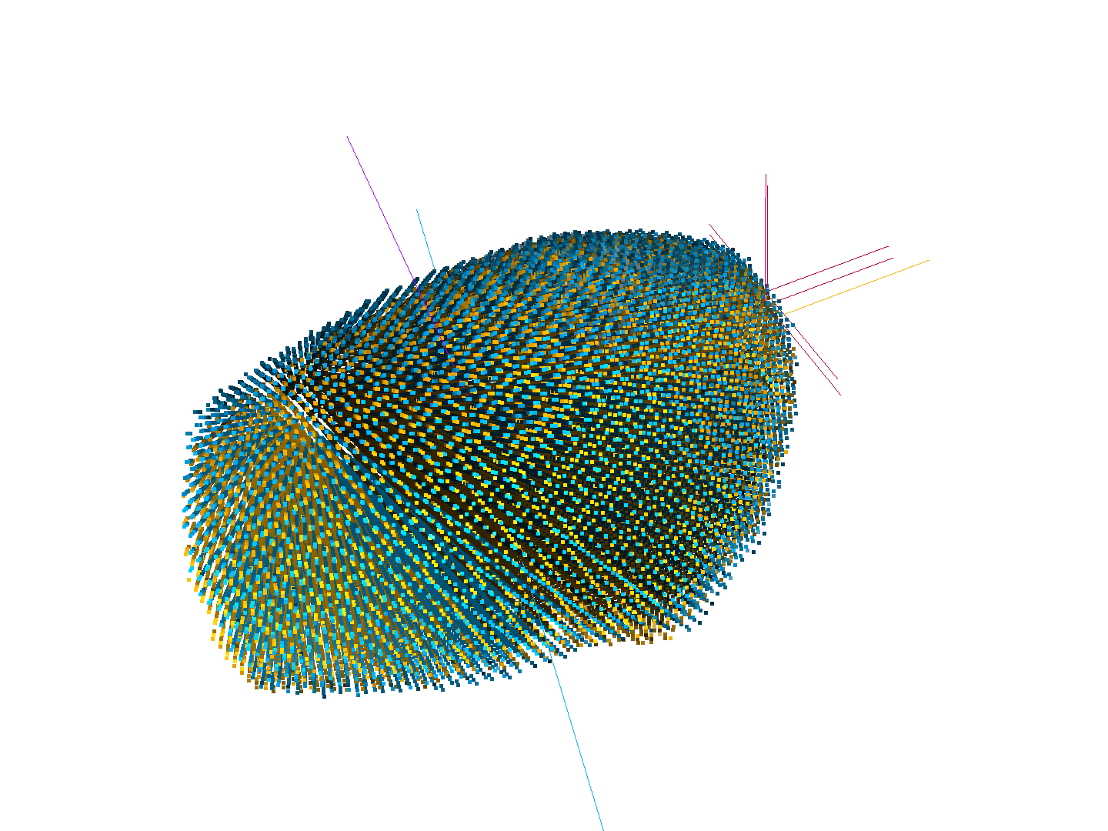
Perfect realignment: done!

Slide 38
Sample evaluation from diffraction stills

Slide 39
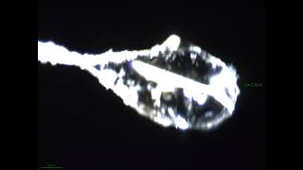
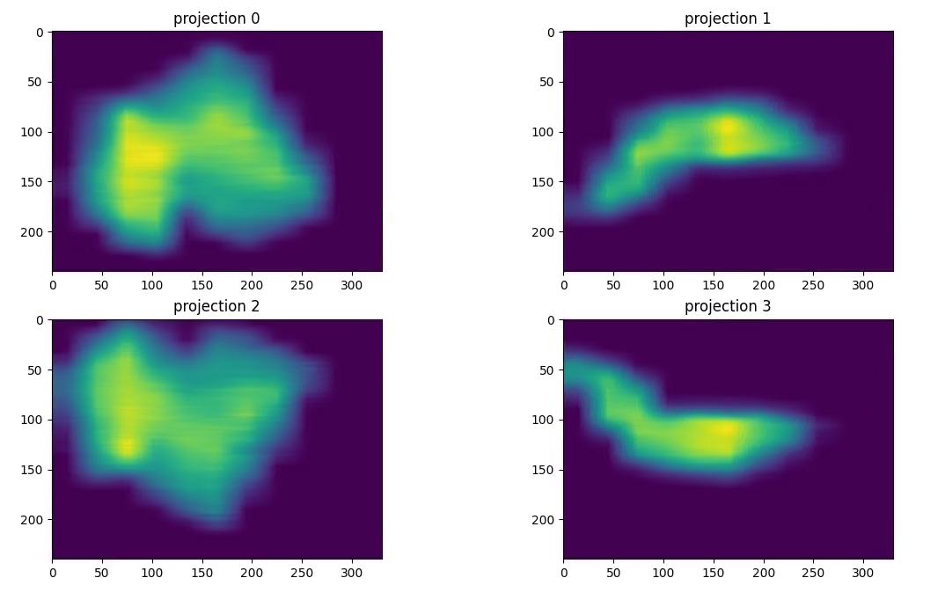
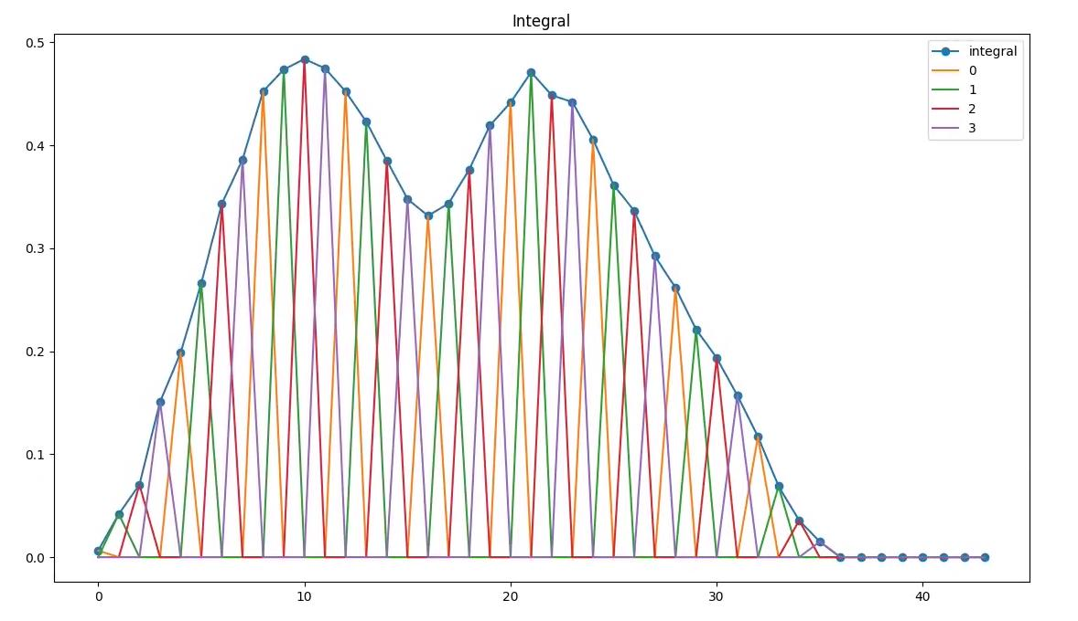
Sample evaluation from diffraction stills

Slide 40
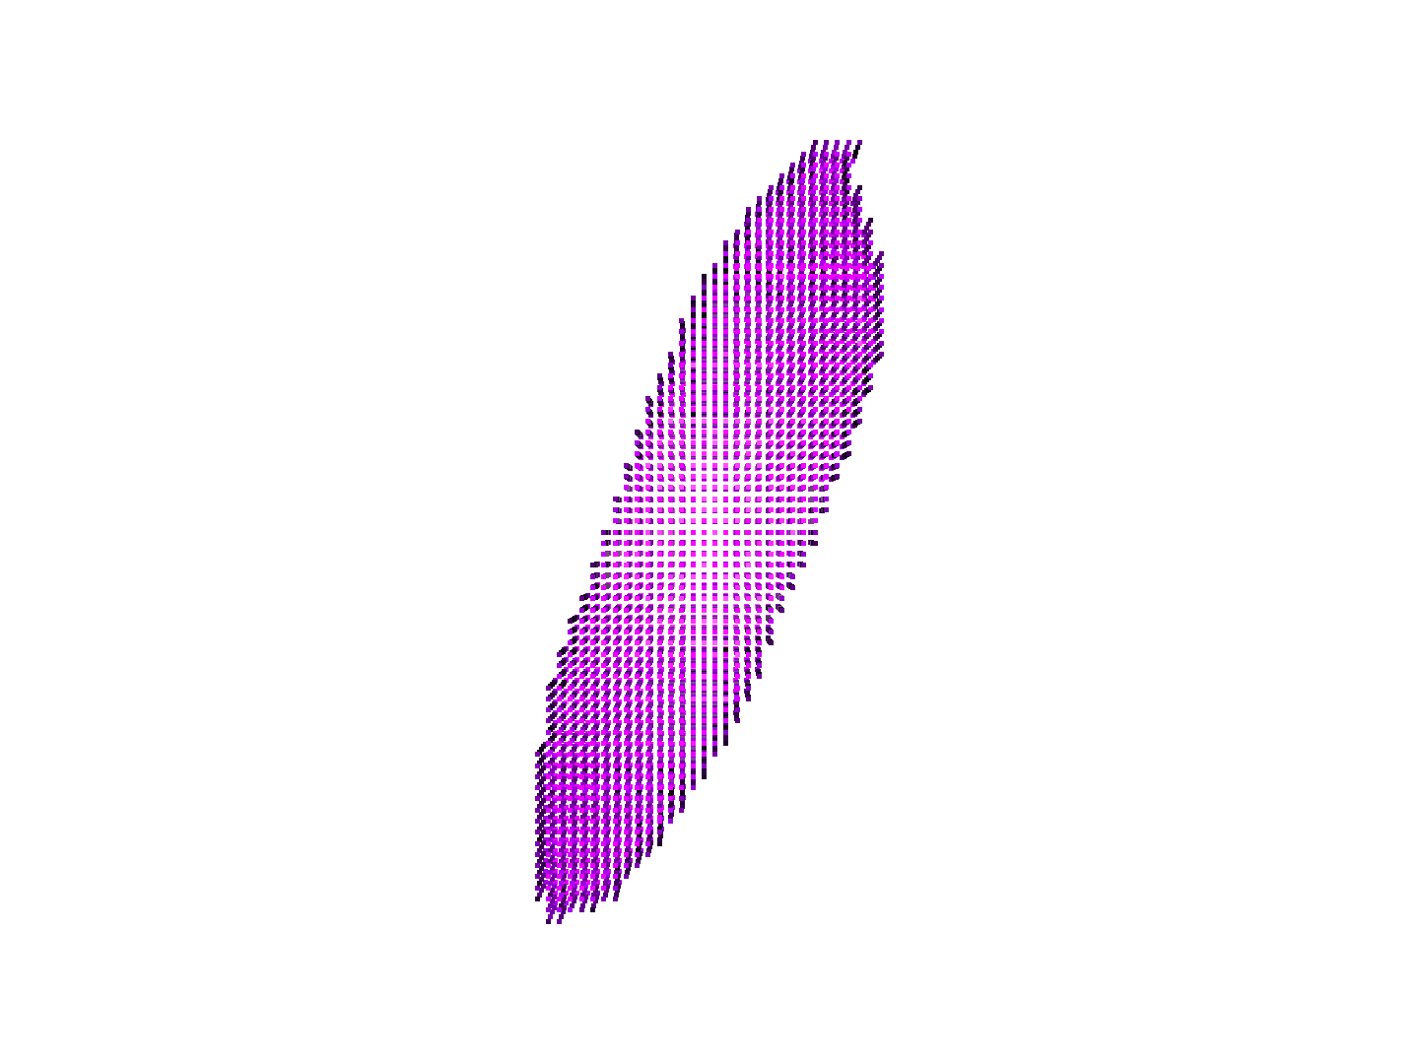
Reconstructed crystal shape (36 projections)

Slide 41
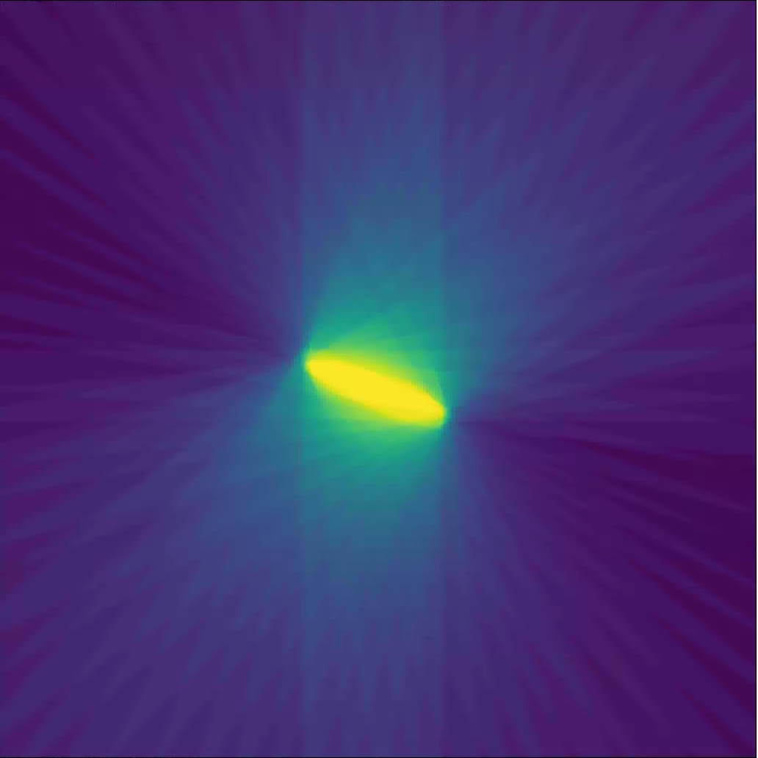
Reconstructing crystal shape (36 projections)

Slide 42
Reconstructed crystal shape (36 projections)

Slide 43
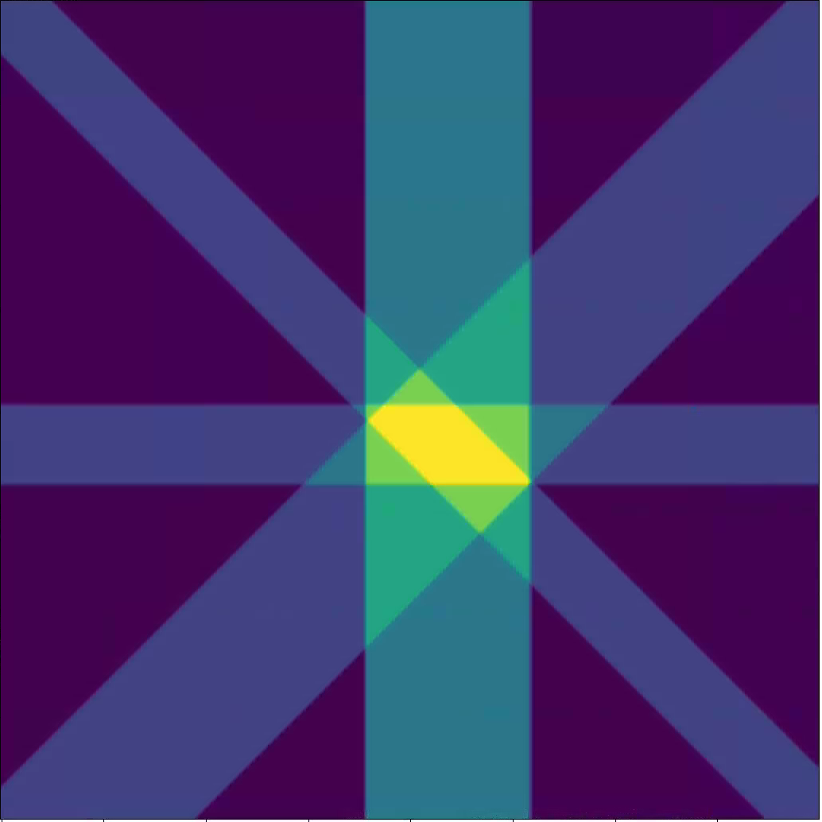
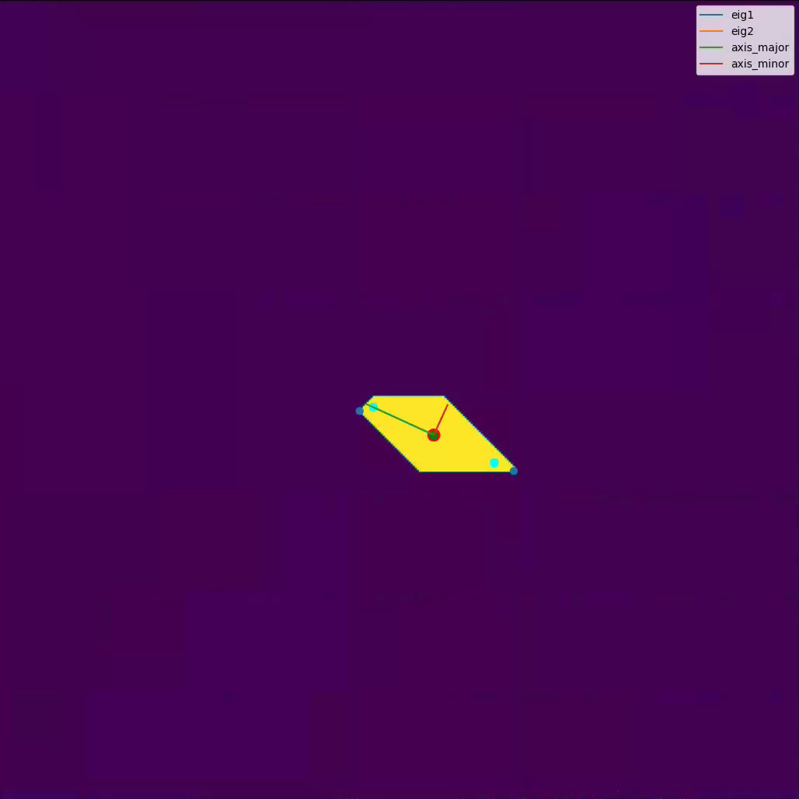
Reconstructed crystal shape (4 projections)

Slide 44
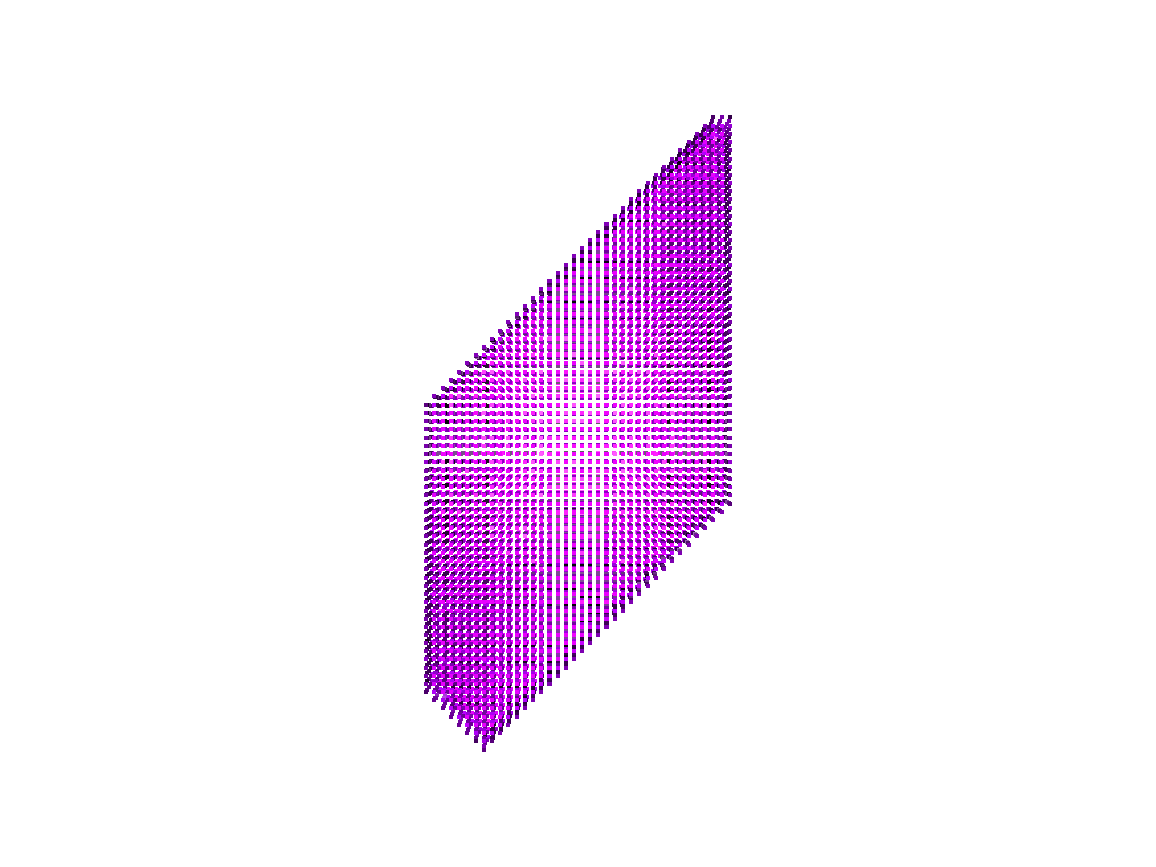
Reconstructing crystal shape (4 projections)

Slide 45
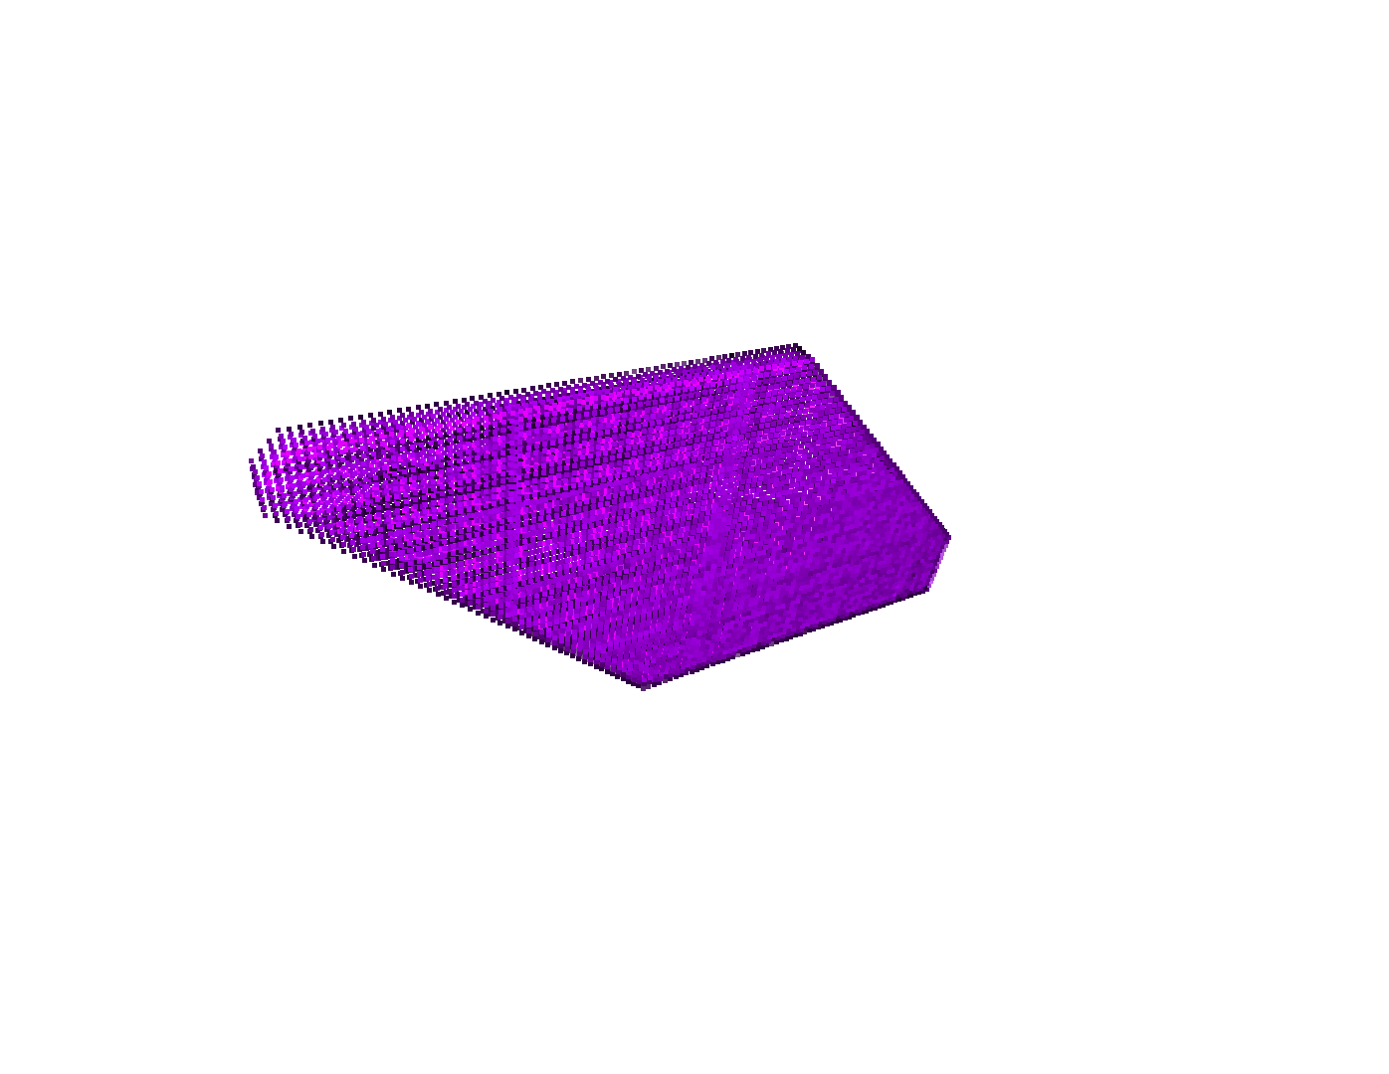
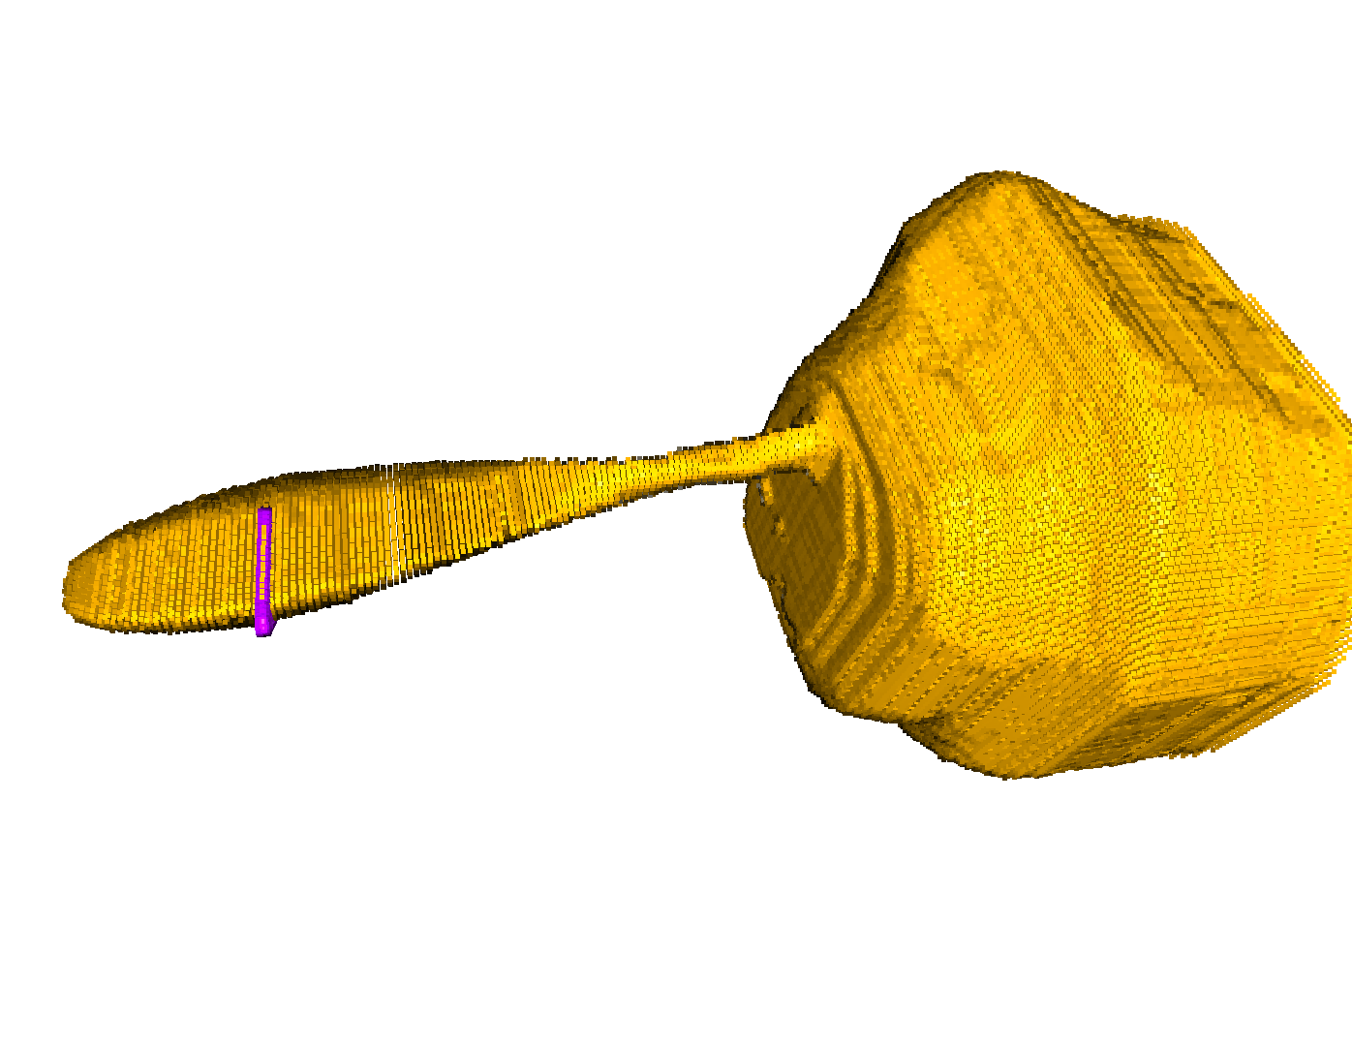
Solution
Merging optical and X-ray information
Combining optical and diffraction contrast tomography then expressing the coordinates of objects in the sample’s intrinsic frame of reference

Slide 46
Perfect realignment !
Merging optical and X-ray information
Combining optical and diffraction contrast tomography then expressing the coordinates of objects in the sample’s intrinsic frame of reference
κ=0°; 𝜑=0°
measured 0;0 (yellow)
calibration (magenta)
measured 95; 50 (blue)
using calibration
transforming to eigen basis
no calibration
κ=95°; 𝜑=50°

Slide 47
Diffraction evaluation from oscillation

Slide 48
Full reciprocal space mapping

Slide 49
Acknowledgements
GPhL team: Rasmus Fogh, Peter Keller, Clemens Vonrhein, Claus Flensburg and Gérard Bricogne
EMBL HH team: Marina Novikova and Gleb Bourenkov
Murko collaboration: Kate Smith and Ezequiel Panepucci (SLS), David Aragao and Ralf Fleig (DLS), Annie Heroux (Elettra), Jie Nan and Isak Lindé (Max IV), Andrey Gruzinov and Thomas White (Desy), Roeland Boer (Alba), Tom Crosskey (Bessy)
SOLEIL team: Bill Shepard, Serena Sirigu, Damien Jeangerard, Eric Larquet, Pierre Legrand, Tatiana Isabet, Robin Lener, Andrew Thompson, Dan Costin

Slide 50
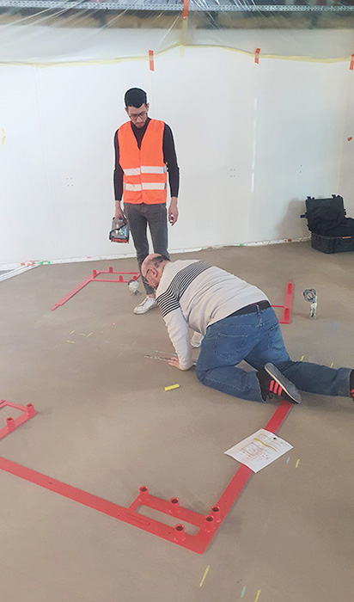
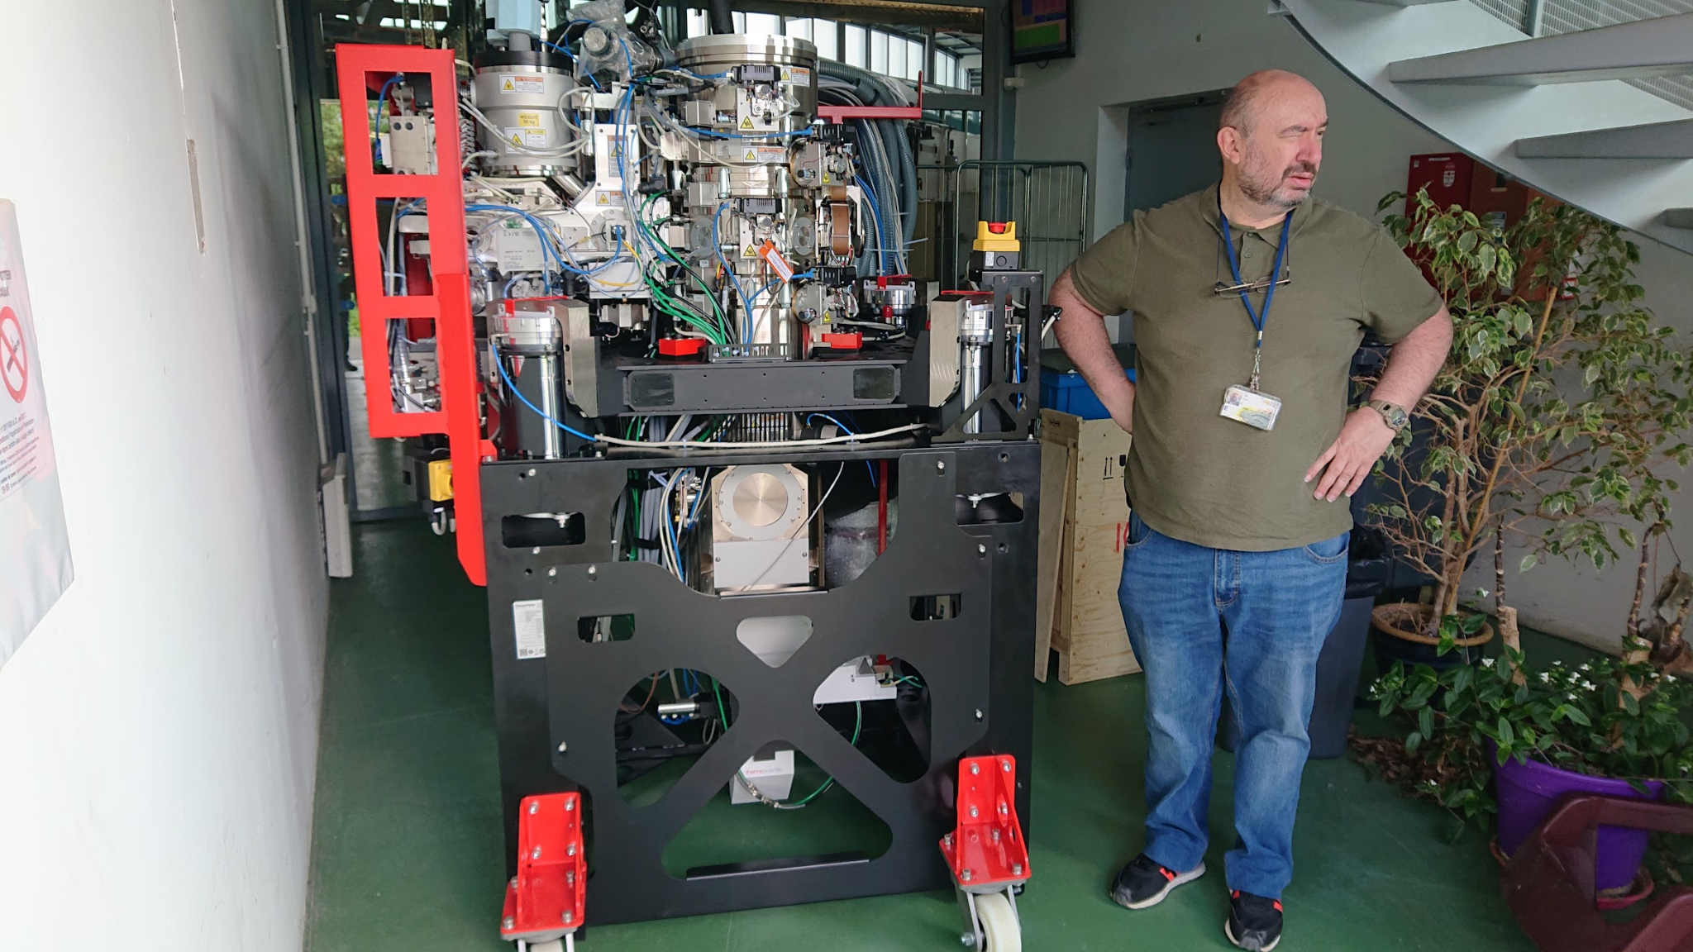
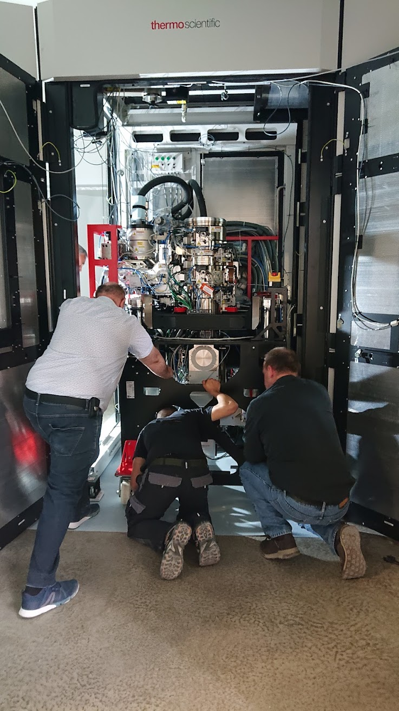
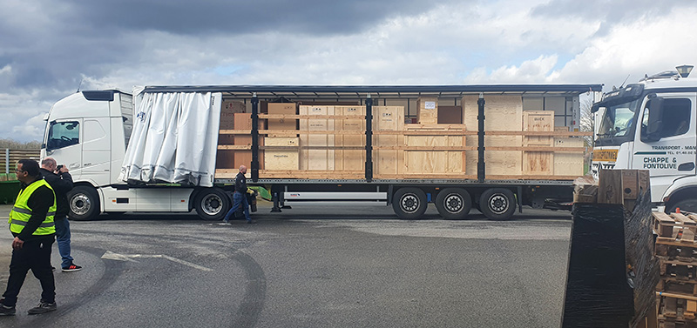
CryoEM@Paris Saclay - POLARIS
ThermoFisher Scientific Titan KRIOS G4
Eric Larquet, Pierre Legrand, Andy Thompson
Polaris beamline
open to users !

